Slide 1
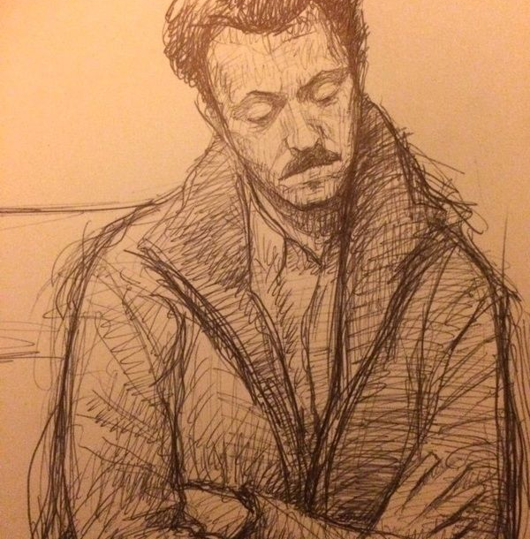
Catching Z’s: A Deep Dive into Drowsiness Detection
Oliver Amirmansour

Slide 2
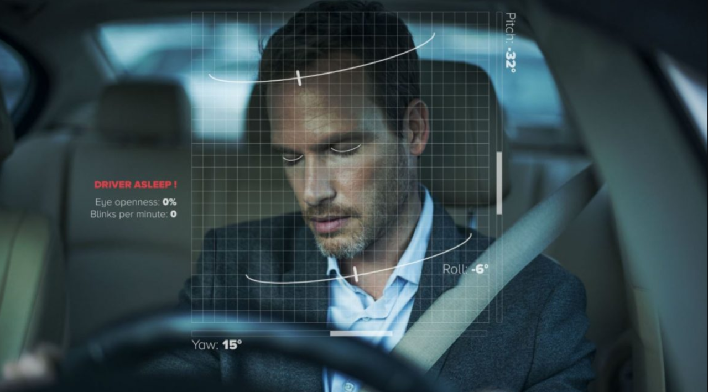
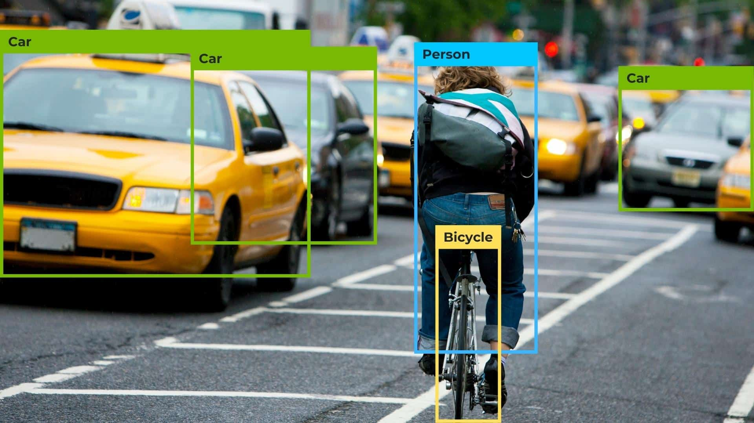
Agenda
Introduction
Project Inspiration
Tech Stack
Challenges & Achievements
Live Demo
Looking to the Future

Slide 3
Introduction
Come from private health insurance
Economics & finance background
Passion & interest for machine learning
Computer Vision & NLP

Slide 4
Project Inspiration

Slide 5
Automotive Applications
Alertness Warning
Increased System Sensitivity
Reduced Distractions

Slide 6
Automotive Applications
Healthcare
Monitoring
Alertness Warning
Increased System Sensitivity
Reduced Distractions
Patient Monitoring
Sleep Disorder Intervention

Slide 7
Tech Stack Dual Approach

Slide 8
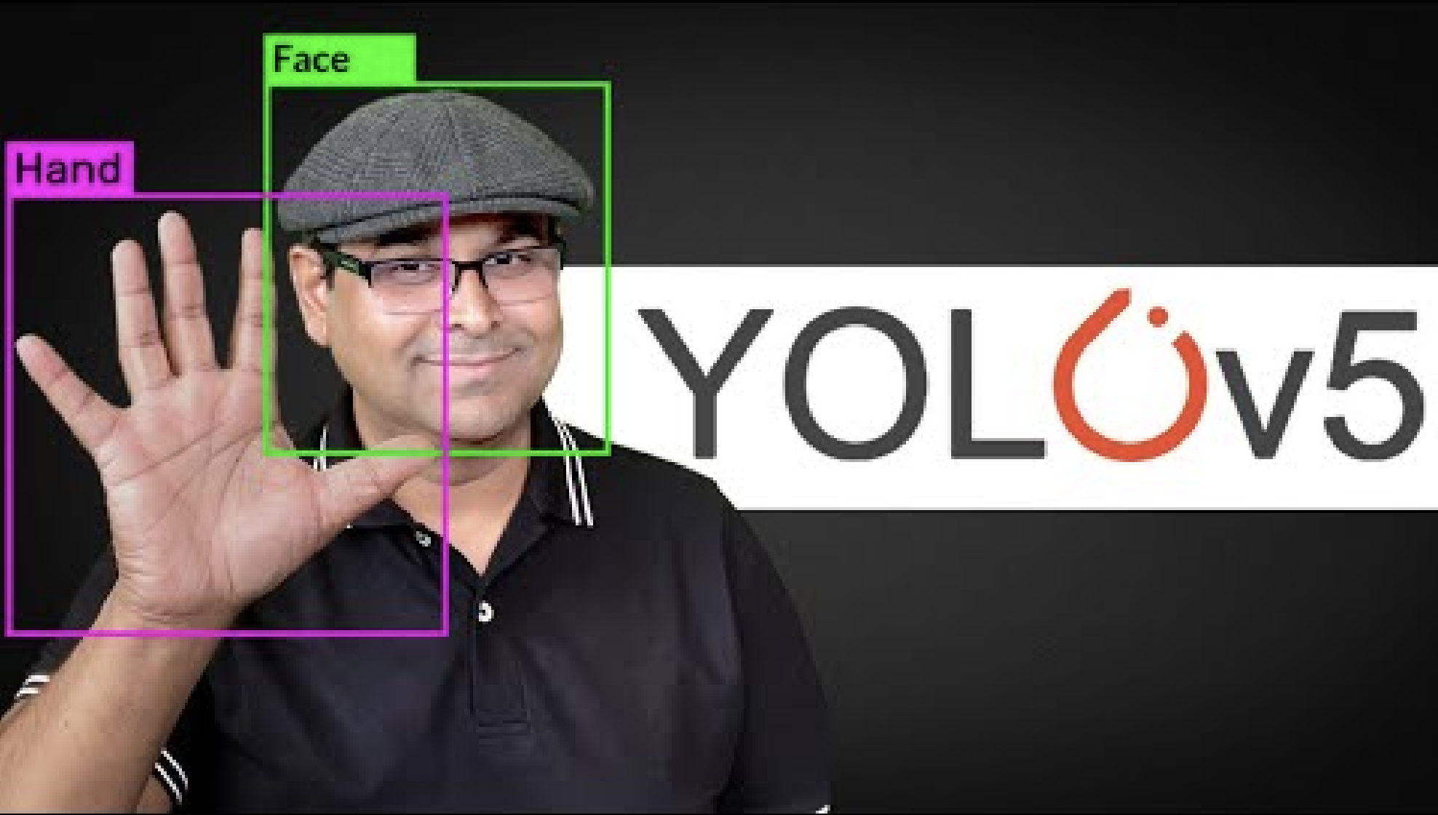
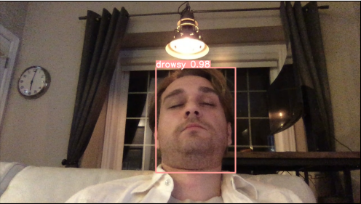
Real-Time Object Detection (YOLOv5)
Gathering Images
OpenCV
Labelling Images
LabelImg Github Repo
Training Model
PyTorch
Testing On Live Feed
OpenCV

Slide 9
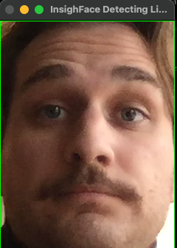
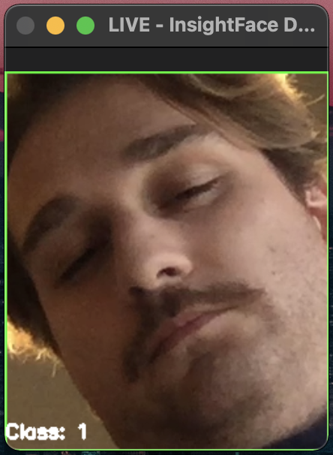
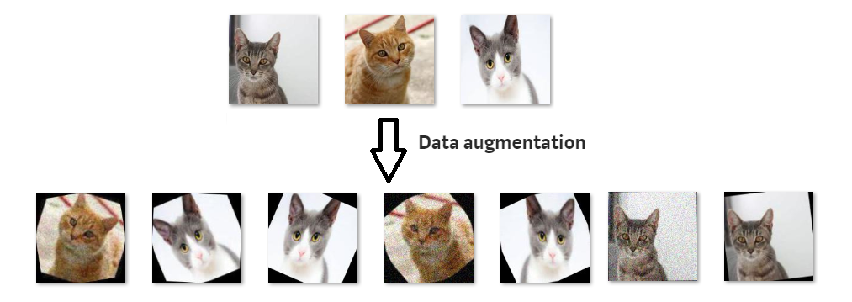
Image Classification (ResNet18)
Gathering Images
OpenCV
Labelling Images
InsightFace
Image Augmentation
PyTorch
Training & Evaluating Model
ResNet18 (CNN)
PyTorch
Sci-kit Learn

Slide 10

Challenges
Size & Quality of Data
More than 376 Images
Variety of Faces & Scenes
Different Genders & Ethnicities

Slide 11
Challenges
Size & Quality of Data
Model Tuning
More than 376 Images
Variety of Faces & Scenes
Different Genders & Ethnicities
Many Hyperparameters
Different Combinations
Strategic & Calculated Approach

Slide 12
Achievements
YOLOv5 Performance
Works on multiple faces
Strong Confidence in Detection
Works in Different backgrounds

Slide 13
Achievements
YOLOv5 Performance
RestNet Performance
Works on multiple faces
Strong Confidence in Detection
Works in Different backgrounds
High Training & Test Accuracy
98.9% vs 92.1%
Small Model (128 hidden layers) Performs Great

Slide 14
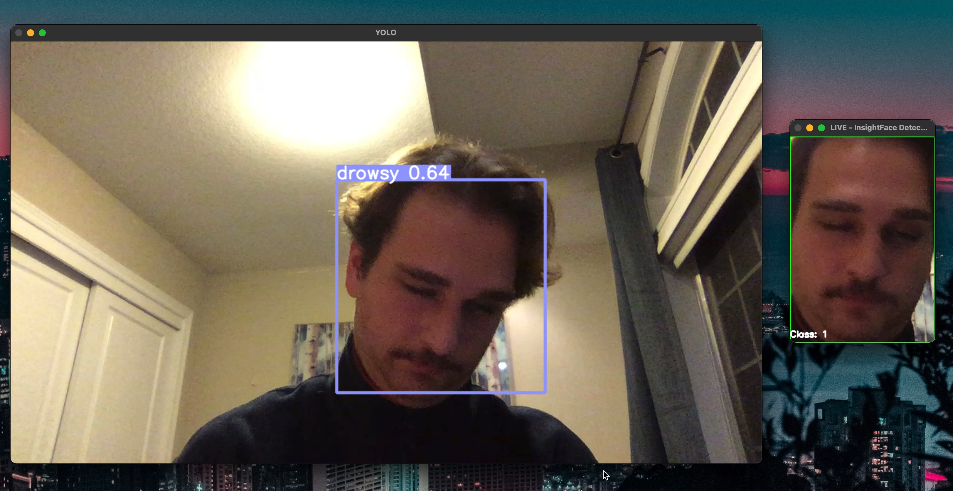
Showcase !
Showcase !

Slide 15
Looking to The Future…
Gathering More Images (Diverse Range)

Slide 16
Looking to The Future…
Gathering More Images (Diverse Range)
Playing around with hyper-parameters

Slide 17
Looking to The Future…
Gathering More Images (Diverse Range)
Playing around with hyper-parameters
Messing around with architecture

Slide 18
Looking to The Future…
Gathering More Images (Diverse Range)
Playing around with hyper-parameters
Messing around with architecture
Deploying in some capacity

Slide 19
THANK YOU
Oliver Amirmansour
Oliver.amirmansour@gmail.com
Github.com/Oliver2552
Special Thanks to Brian Lynch & Mentors

